Slide 1
Wasserstein-Splitting Gaussian Process Regression for Heterogenous Online Bayesian Inference
Michael E. Kepler*, Alec Koppel†, Amrit S. Bedi†, Daniel J. Stilwell*
*Virginia Tech, †U.S. Army Research Lab
ICRA 2021
Notes:
Hello my name is Michael Kepler, and in this video we provide a brief overview of our new regression approach, and we illustrate the approach using a 1-dimensional dataset.

Slide 2
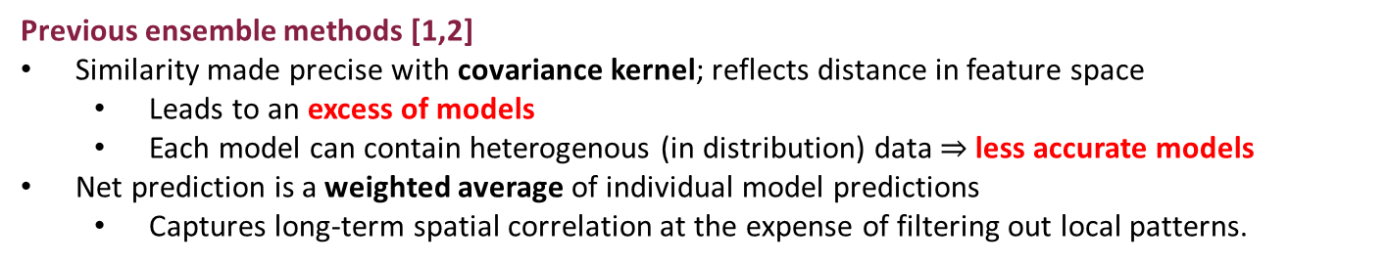
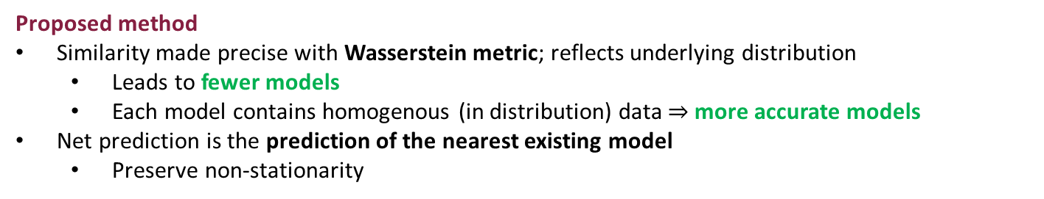
Overview
Objective: Adaptively estimate spatial field $f:𝒳→ℝ,$ which need not be stationary.
Employ ensemble of Gaussian process models
Given new data, training requires updating an existing model or instantiating a new one based on how “similar” new data is to each existing model.
Previous ensemble methods [1,2]
Similarity made precise with covariance kernel; reflects distance in feature space
  Leads to an excess of models
  Each model can contain heterogenous (in distribution) data $⇒$ less accurate models
Net prediction is a weighted average of individual model predictions
  Captures long-term spatial correlation at the expense of filtering out local patterns.
Proposed method
Similarity made precise with Wasserstein metric; reflects underlying distribution
  Leads to fewer models
  Each model contains homogenous (in distribution) data$⇒$ more accurate models
Net prediction is the prediction of the nearest existing model
  Preserve non-stationarity
[1] Nguyen-Tuong, Duy, Matthias Seeger, and Jan Peters. "Model learning with local gaussian process regression." Advanced Robotics 23.15 (2009): 2015-2034.
[2] Wilcox, Brian, and Michael C. Yip. "SOLAR-GP: Sparse Online Locally Adaptive Regression Using Gaussian Processes for Bayesian Robot Model Learning and Control." IEEE Robotics and Automation Letters 5.2 (2020): 2832-2839.
Notes:
Our objective is to iteratively estimate a spatial field which need not be stationary. (CLICK FOR NEXT)
To do so, we adopt the approach of employing a collection of Gaussian process models.
When a new batch of training data is collected, we must decide whether to use the new data to update an existing model or to instantiate a new one. The decision ultimately hinges on how “similar” the new data is to each existing model. (CLICK FOR NEXT)
Previous ensemble methods define similarity in terms of the covariance kernel, which reflects distance in feature space. Thus, each model is associated with a particular region of the domain. This often leads to an excess of models. And because a region may contain data from various distributions, the model of that region may be less accurate. Additionally, the net prediction of the ensemble is the weighted average of individual model predictions, which captures long-term spatial correlation at the expense of filtering out local patterns. (CLICK FOR NEXT)
By using the Wasserstein metric to make similarity precise, we are capable of identifying the number of models associated with the underlying distribution. And since each model is created on the basis of the underlying distribution, models are more likely to contain homogenous data, leading to more accurate individual models. In an effort to preserve non-stationarity, the net prediction of the ensemble uses the prediction of the nearest existing model

Slide 3
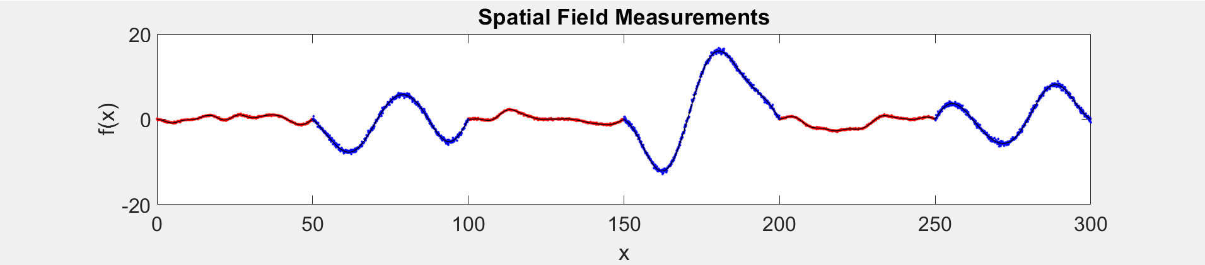
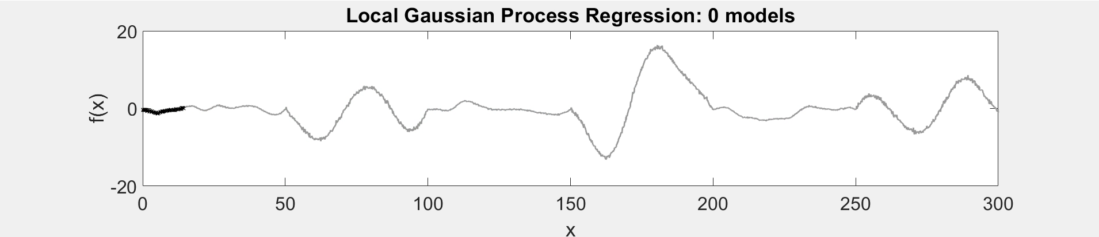
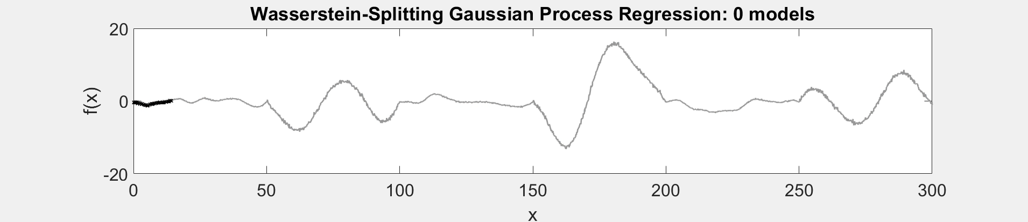
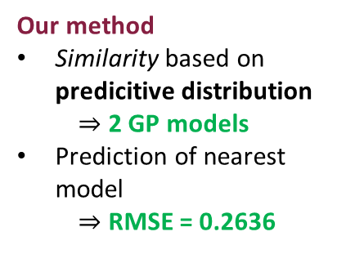
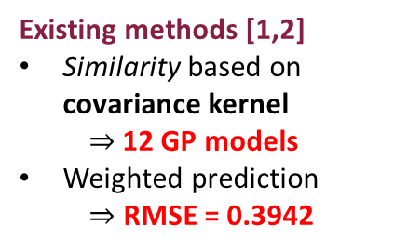
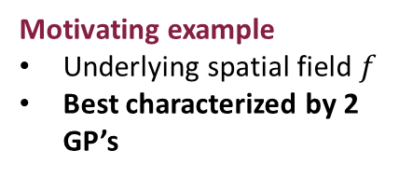
Wasserstein-Splitting Gaussian Process Regression
Motivating example
Underlying spatial field $f$
Best characterized by 2 GP’s
Training data 1
Training data 2
Existing methods [1,2]
Similarity based on covariance kernel
  $⇒$12 GP models
Weighted prediction
$⇒$ RMSE = 0.3942
Underlying function
Model pseudo-points
Model centers
Our method
Similarity based on predicitive distribution
  $⇒$ 2 GP models
Prediction of nearest model
  $⇒$ RMSE = 0.2636
Underlying function
Model pseudo-points
[1] Nguyen-Tuong, Duy, Matthias Seeger, and Jan Peters. "Model learning with local gaussian process regression." Advanced Robotics 23.15 (2009): 2015-2034.
[2] Wilcox, Brian, and Michael C. Yip. "SOLAR-GP: Sparse Online Locally Adaptive Regression Using Gaussian Processes for Bayesian Robot Model Learning and Control." IEEE Robotics and Automation Letters 5.2 (2020): 2832-2839.
Notes:
To make the notions on the previous slide more concrete, consider the spatial field on the right-hand side. Ideally, this spatial field could be best characterized by the 2 Gaussian processes shown in red and blue. (CLICK FOR NEXT)
(START VIDEO) Existing methods base similarity on the covariance kernel and instantiate a new model provided the training data is sufficiently far from existing models. This gives rise to 12 local models despite needing only two models to adequately estimate the spatial field. This video shows local models being built as more training data is collected. The circles correspond to the pseudo-points of each model, and the triangles at the bottom denote the geometric centers for each model. With weighted prediction, existing methods achieve an RMSE of 0-point-3-9. (CLICK FOR NEXT)
(START VIDEO) Our method, on the other hand, bases similarity on the underlying posterior predictive distribution so we are able to identify the two underlying models, as seen in the video. This combined with using the prediction of the nearest model, we are able to outperform existing methods with an RMSE of 0-point-2-6.
Thus, by redefining the similarity metric to reflect the underlying distributions, and using the prediction of the nearest model, our method is well-equipped to model non-stationary spatial fields. Thank you for watching.

